Slide 1
Poverty and the Effects on Education
January 13, 2016
Christina M. Savino
Program Specialist, Homeless Education

Slide 2
Our Vision
To be the top producer of successful students in the nation
Our Mission
To lead our students to success with the support and involvement
of families and the community

Slide 3
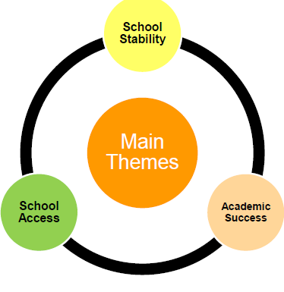
The McKinney-Vento Act
Protects the educational
rights of children
and youth experiencing
homelessness
Federal law
First enacted in 1987
Reauthorized in 2001 as part of the No Child Left Behind (NCLB) Act.

Slide 4
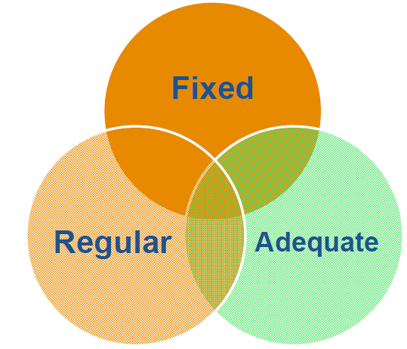
Who is covered under the Act?
All students who lack a fixed, regular and adequate nighttime residence
Housing Categories
Emergency shelters/transitional housing
Sharing housing due to loss of housing/economic hardship
Cars, parks, public spaces, bus or train stations
Motel, hotels, trailer parks, or campgrounds
Awaiting foster care placement

Slide 5
Awaiting Foster Care
< 1%
Hotel
23%
Shelter
6%
Shared Housing
70%
Total: 6,800
* 290 of these students were unaccompanied without a parent or legal guardian

Slide 6
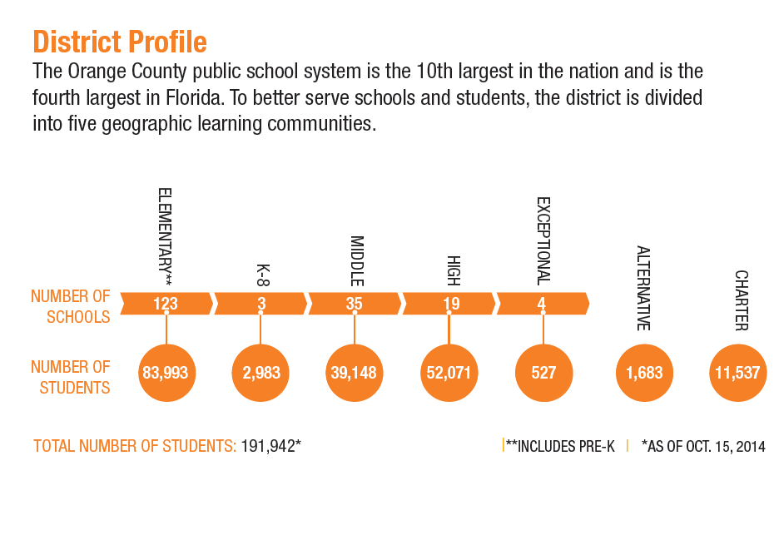
District Profile
The Orange County Public school system is the 10th largest in the nation and is the fourth largest in Florida.

Slide 7
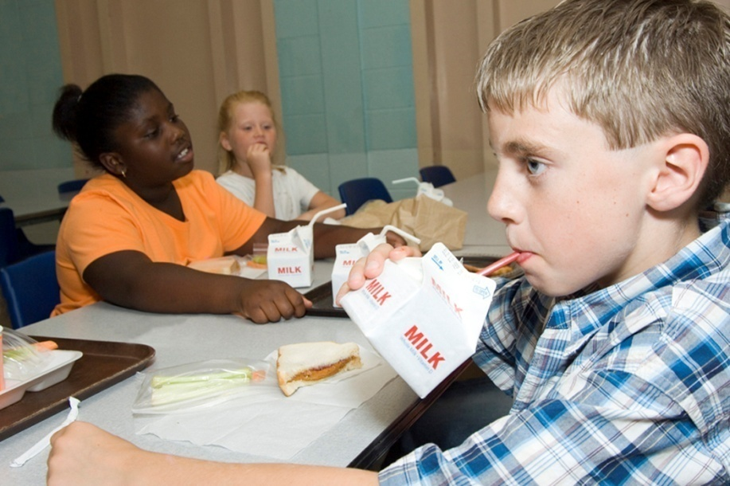
* Impact of Poverty on Youth
Health and Nutrition
Lack of preventative care and food instability
Food with lower nutritional value
Vocabulary
Smaller vocabulary which impacts learning, memory and cognition
Risk of academic failure
Hope and Growth Mind-Set
Lowered expectations about future outcomes
Negative mindset which may impact effort

Slide 8
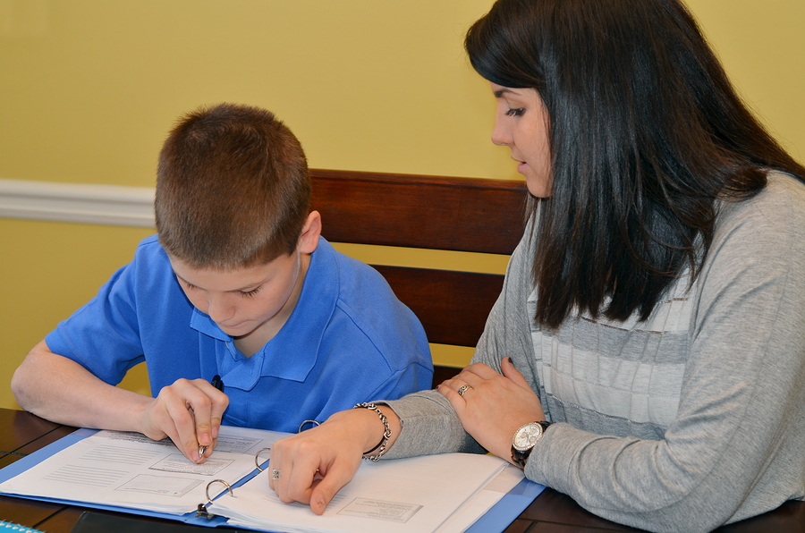
* Impact on Youth cont.
Cognition
Short attention spans and high level of distraction
Potential behavior issues
Distress
Chronic stress
Increased assertiveness or disconnect
* May 2013, Volume 70, Number 8, Faces of Poverty Pages 24-30

Slide 9
Impact on Education
Increased absenteeism
Lower achievement scores on standardized tests
Increased grade retention
4-6 months estimated academic recovery time after changing schools
Mobility during high school greatly diminishes the likelihood of graduation

Slide 10
Be aware of resources
School resources
Community resources or path to
Games, movement, deep breathing
Never withhold recess
Physical activity to build health
* What can you do?

Slide 11
Vocabulary building
Introduce new words through engaging activities
“Word of the Day”
Set high goals, affirm, guide
Connect learning to real world
Encourage and reinforce effort
* What can you do?

Slide 12
* What can you do?
Focus on core academic skills
Start with basics (organize, study,
take notes, remember key ideas)
Start small, then build higher-level skills
Build relationships, encourage responsibility and leadership, teach coping skills
“If this, then that”
Reduce stress with more fun!
* May 2013, Volume 70, Number 8, Faces of Poverty Pages 24-30

Slide 13
Remember . . .
“Remember, student in poverty are not broken or damaged. In fact, human brains adapt to experiences by making changes – and your students can change.”
~ Eric Jenson, Author

Slide 14
What we’re all about . . .
“…Through it all, school is probably the only thing that has kept me going. I know that every day that I walk in those doors, I can stop thinking about my problems for the next six hours and concentrate on what is most important to me. Without the support of my school system, I would not be as well off as I am today. School keeps me motivated to move on, and encourages me to find a better life for myself.”
Carrie Arnold, LeTendre Scholar

