Slide 1
Kindness and Compassion
The foundation for learning
READ2SUCCEED PROGRAM

Slide 2
“People don't care how much you know until they know how much you care.” John C. Maxwell

Slide 3
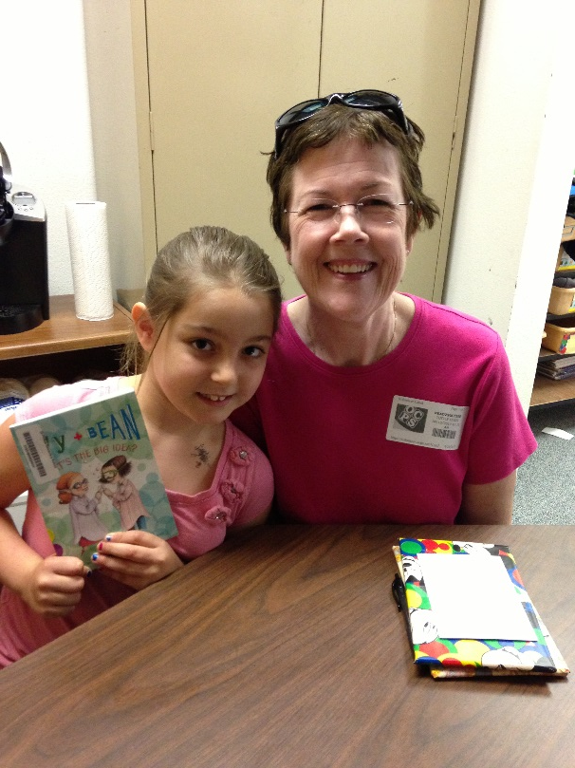
Healthy social and emotional development
A child’s capacity to identify, understand, experience, manage, and express a full range of positive and negative emotions in a productive way
A child’s ability to regulate one’s own behavior
Being able to calm down
Being able to accurately read another person’s emotions
Develop empathy for others
Develop and sustain close, satisfying relationships with other children and adults;
Actively explore the environment and learn. (www.seedsofcompassion.org)

Slide 4
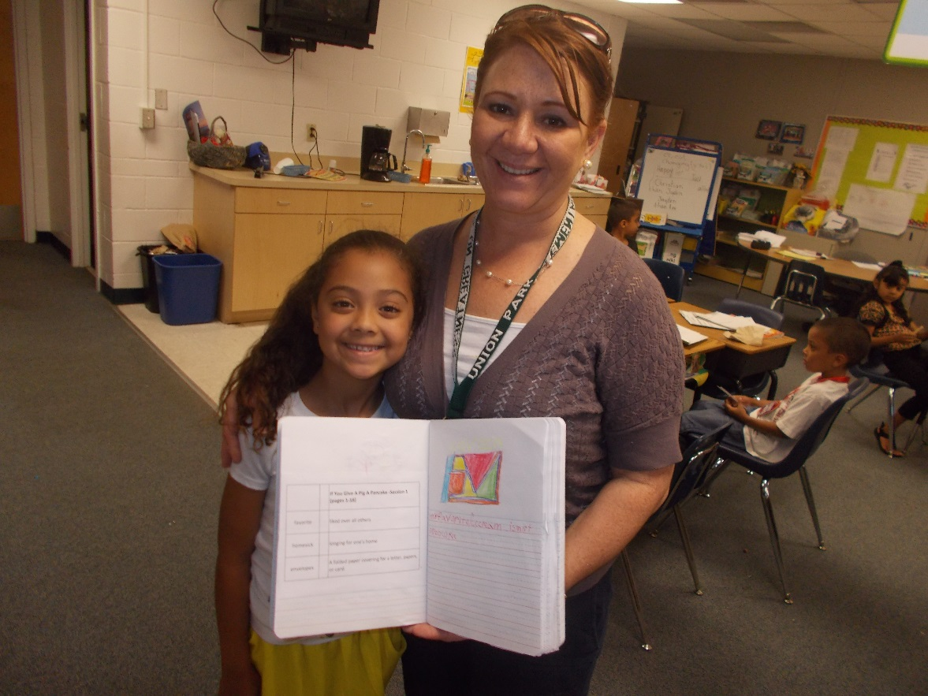
How can we make a difference?

Slide 5
Respect one another
Treat the children with the same respect you would treat someone you are trying to impress. Use please, thank you.

Slide 6
Begin positively
Help the children understand that they are capable of this work.
I think we will have a great session today.
I am so happy to be with you today.
You are going to do great work today. I can feel it!

Slide 7
Cross Body Movement
These are movements that cause the arms and legs to cross over the mid-line of the body
This movement causes the left side of the brain to work together with the right side of the brain.
This is important for activities such as reading and writing which require the hand and eye to cross the mid-line.

Slide 8
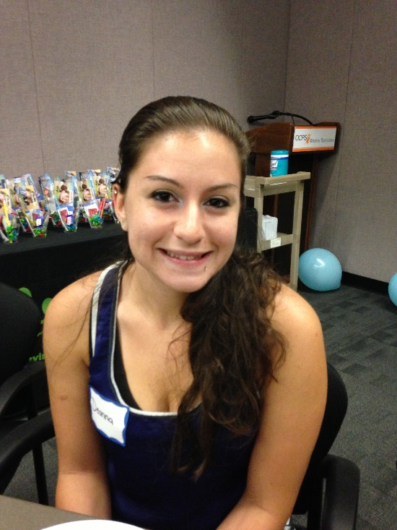
Model good behavior
What most inspires a child to grow up caring about others is the caring that the child receives.
That nurturing is itself a perfect role model for children.
Experts point out that when children feel they have a secure base at home, they're more likely to venture out and pay attention to others.
It's when they feel deprived of love and nurturing that they focus too much on themselves and their own needs.
An excerpt from an online article from the American Psychological Association website.
Smile when you first see your student.
Look at them with kindness in your eyes.

Slide 9
Focus on the positive
Your children want to please you. They love to hear words of encouragement.
They like to see you smile, and they want to know that they make you proud.
Try to come up with something positive that went well last week or the current week. A concrete example of them doing something well.

Slide 10
Work side by side
Show them how you learn as you go.
Making mistakes is okay.
Show resiliency.
Let go of your need to be right.

Slide 11
Correct with Kindness
Remember to separate the behavior from the child.
Always be patient.
If you begin to feel frustrated while teaching a new task, step away.
Let them know that even though their behavior is being corrected that you still enjoy their company and think they are a great kid.
Even when they are frustrated with you that you still like them.

Slide 12
Listen
Listen carefully to what the children are saying and the emotion behind it.
Validate the emotion.
“Listen a second longer than you have patience for” Alyssa Marquess, www.creativewithkids.com

Slide 13
Have fun!
Play games
Be silly
Enjoy yourself and the kids will enjoy themselves too!

Slide 14
Trust that you are enough
When kids know your care they care too
Being a consistent presence can change a life
Another loving adult can make a difference to a child

Slide 15
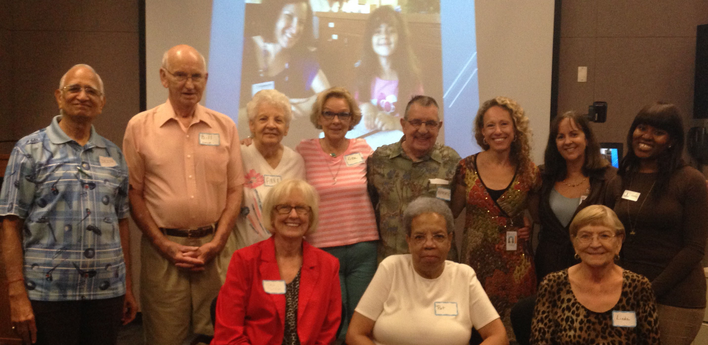
“Too often we underestimate the power of a touch, a smile, a kind word, a listening ear, an honest compliment, or the smallest act of caring, all of which have the potential to turn a life around.”
― Leo Buscaglia

Slide 16
Thank you for all you do for our children!

