Slide 1
R2S 3rd Grade Reading Comprehension Program
Notes:
Welcome to this overview of the third grade portfolio

Slide 2
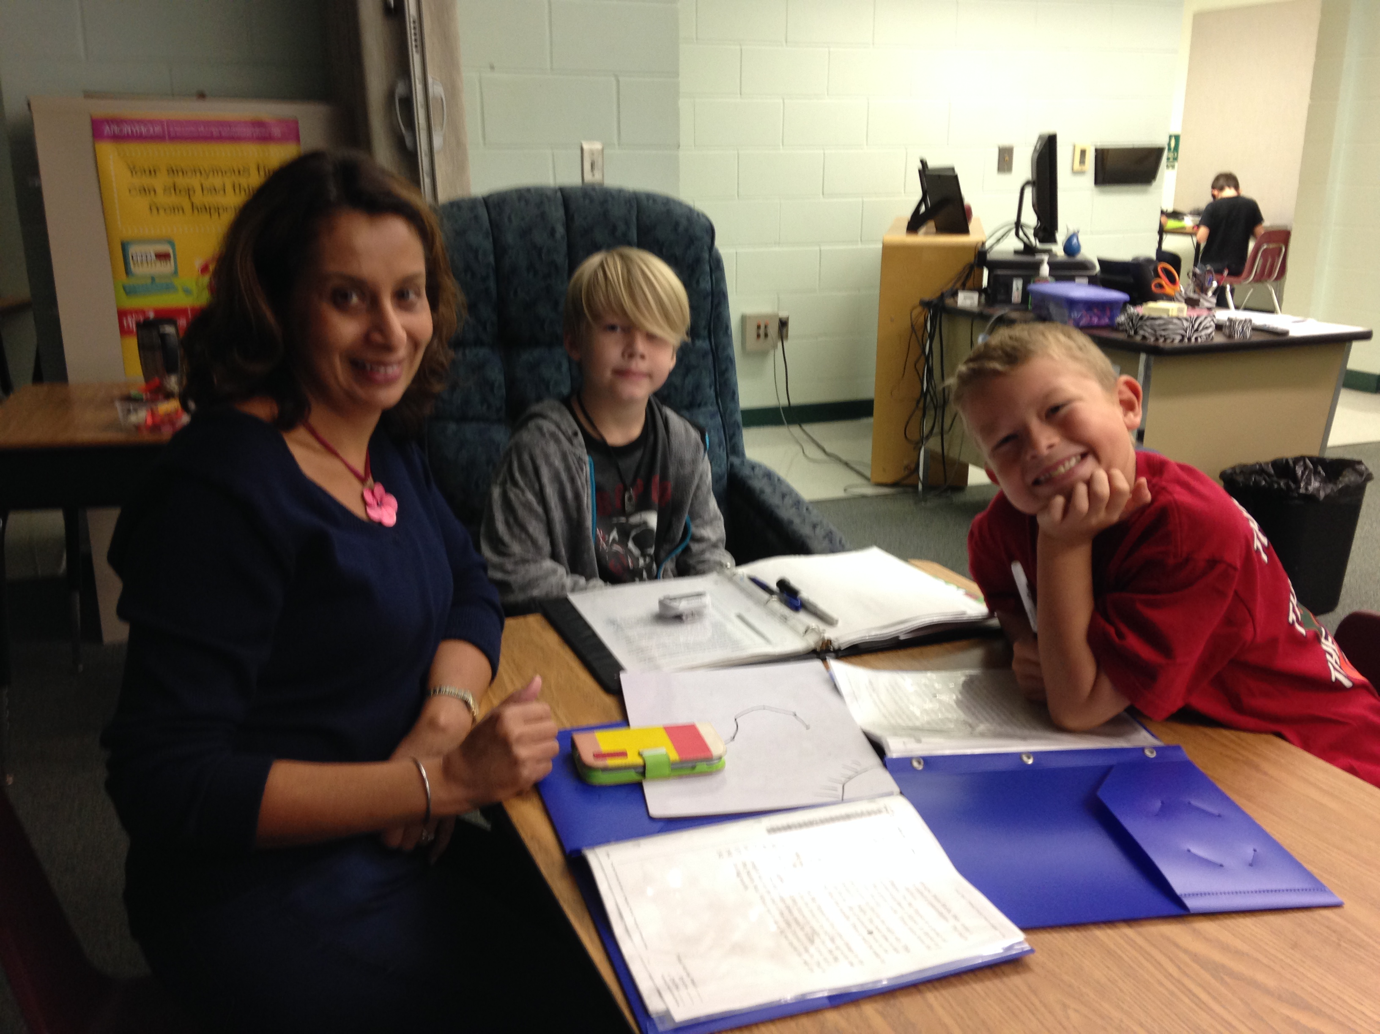
Fluent Decoding Phonological Awareness Phonemic Awareness Phonics Vocabulary
Prerequisites to Reading Comprehension

Slide 3
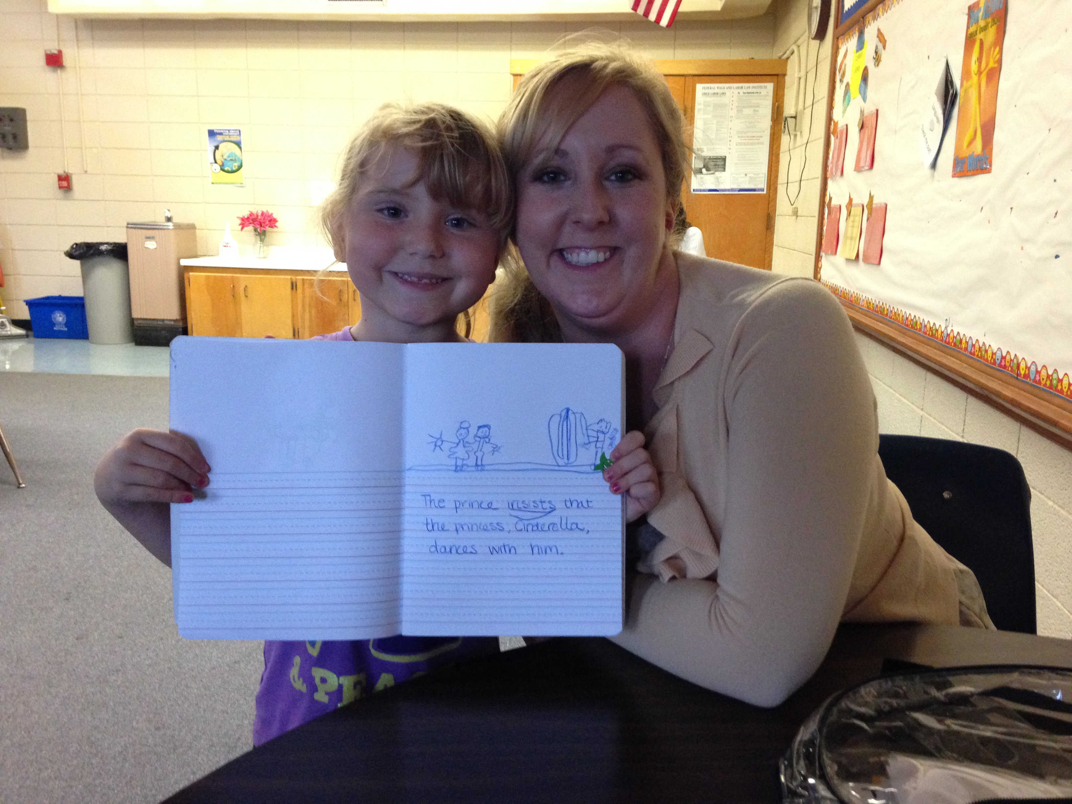
Elements of Reading Comprehension
Monitoring comprehension (Metacognition)
Visualizing
Asking reflective questions
Making inferences
Determining importance
Synthesizing information

Slide 4
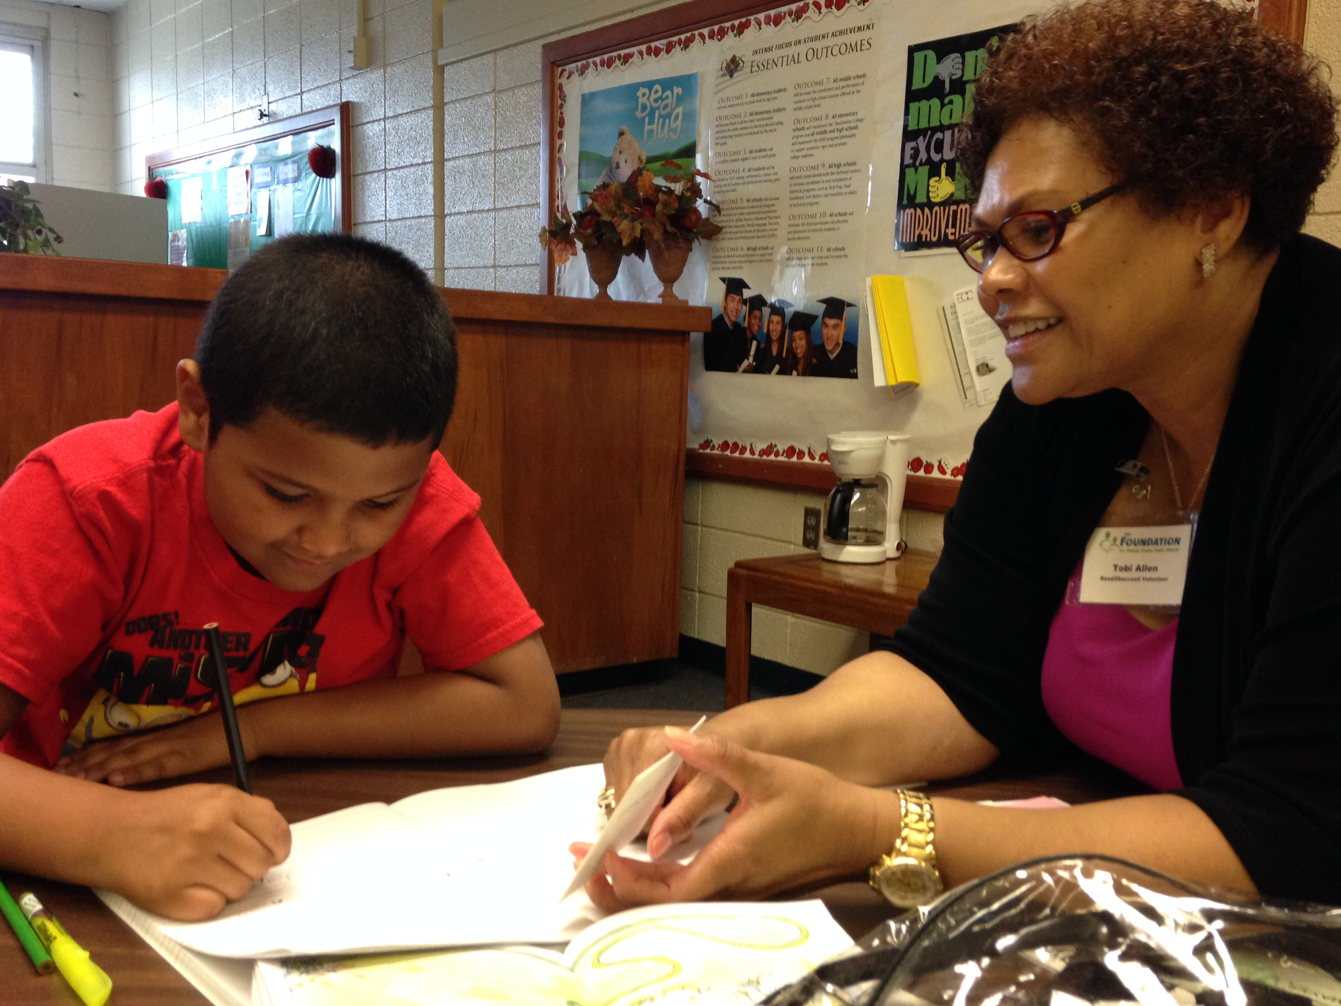
Why 3rd grade?
Mandatory retention
Critical juncture
Shift from learning to read to reading to learn

Slide 5
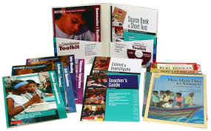
The Comprehension Toolkit
Addresses critical elements of comprehension
Uses complex text that is on grade level
Majority of text is non-fiction

Slide 6
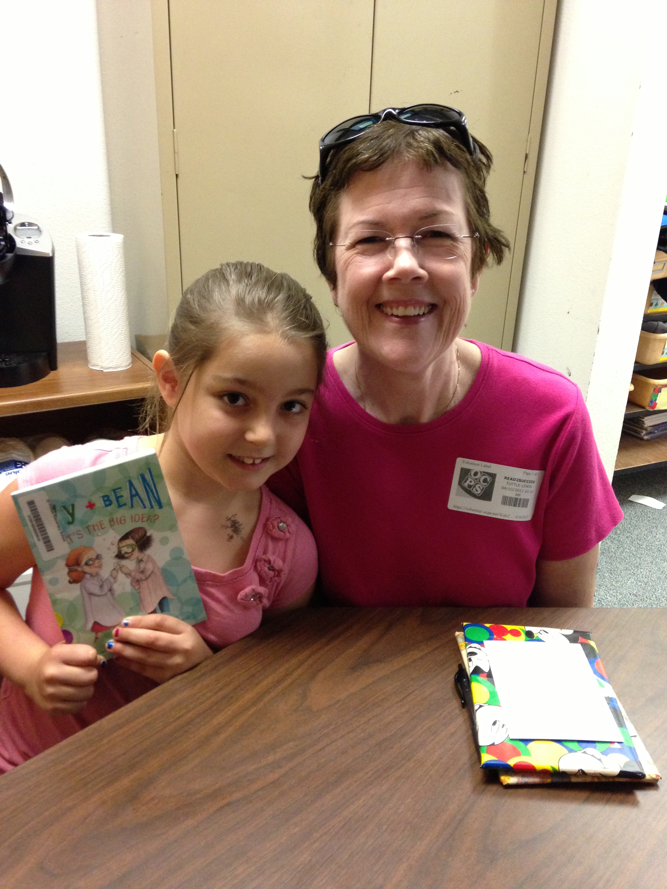
What is this like in action?
Certified teachers implementing with individual students or pairs of students
Adaptations being made to individualize the program (dictionaries, supplemental texts, etc.)

Slide 7
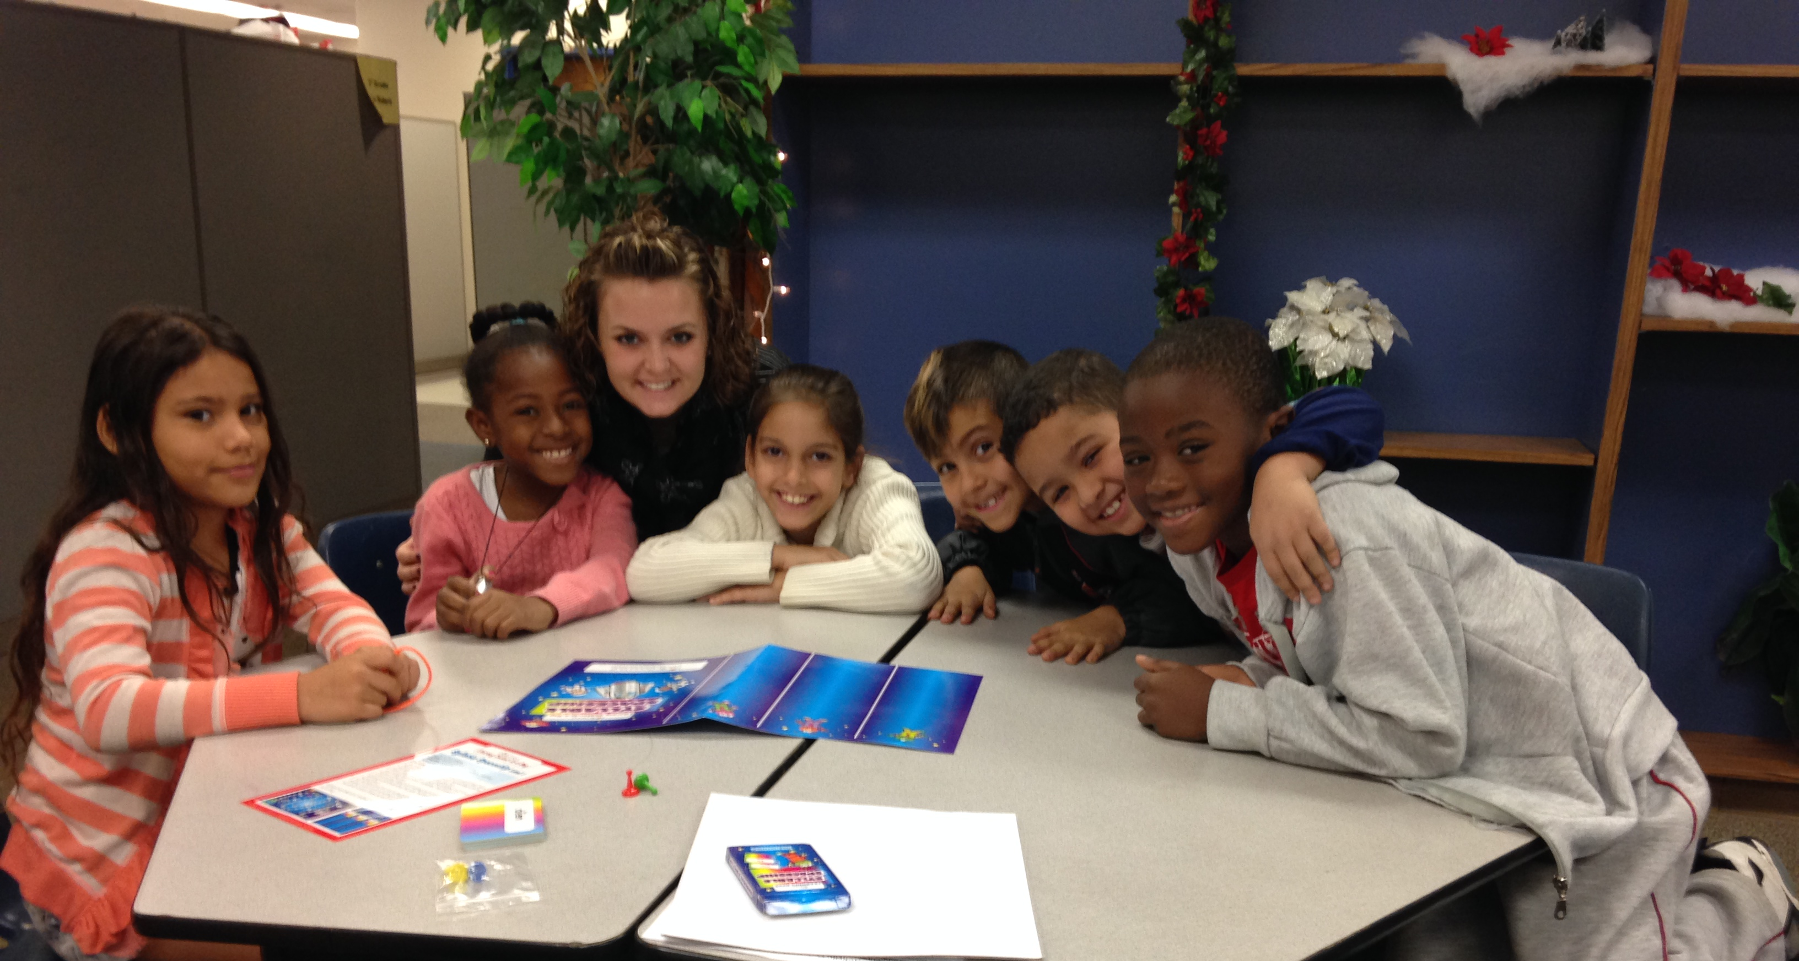
Evaluating the Impact
Rubric developed to measure specific comprehension skills
Pre- and post measures
Outside measures (FSA, MAP, etc.)

Slide 8
Questions?
Meg Bowen
Director, Elementary Curriculum and Instruction (marguerite.bowen@ocps.net)

