Slide 1
Welcome Read2Succeed Volunteers! Training Orientation

Slide 2
Staff Contacts:
Elizabeth Conrad - Administrator, Read2Succeed
elizabeth.conrad@ocps.net
Kt (Katie) Paxton – Read2Succeed Coordinator
kt.Paxton3@ocps.net
Read2Succeed@ocps.net

Slide 3
Read2Succeed Local & National Sponsors

Slide 4
Read2Succeed Program Overview
Foundation for OCPS
Curriculum and Digital Learning
Participating Schools
Reading tutors
Grades served

Slide 5
Read2Succeed Goals
Read2Succeed provides tutoring and mentoring to first and second grade students reading below grade level.
Goals:
Pass on a love for books and impart a strong affirmation for reading and learning
Instill positive attitudes toward reading
Help students gain vital skills in social and personal development
Make progress in the targeted reading skills
Have fun and return students to class happy

Slide 6
Read2Succeed Reading Volunteers
Meet with one or more students
Once or twice a week
30 - 40 minutes
Single or paired students
On school campus
During school hours

Slide 7
Volunteer Guidelines
Dress code
Checking-in at your school
Meeting with your student
Physical contact
Volunteers as role models
Confidentiality
Disciplining of students
Absences
Commitment
School calendar
School safety poster
Covid-19

Slide 8
First Grade Vocabulary Enhancement Program

Slide 9
First Grade Vocabulary Enhancement Program
Created to increase and improve student’s vocabulary and background knowledge
Improvements are measured by administration of a pre-and post-test, in addition to district approved assessments
Students selected to participate are identified by their teacher or reading coach and i-Ready district assessment
Program is non-remedial and administered by non-educators; students should have a basic understanding of story elements and be willing to learn in a one-on-one environment
Students will not be required to read aloud but are rather called upon to discuss story structure, story elements, words and their meaning. Students will participate in a journal activity each session

Slide 10
PROGRAM STEP-BY-STEP
Step 1: Connect with the student.
Step 2: Read/Review rules of the program.
Step 3: Introduce/review the book you’re currently reading.
Step 4: Introduce new vocabulary words for student.
Step 5: Tutor reads book aloud; student listens for new words and highlights. Stop at designated stopping point.
Step 6: Review the session’s new vocabulary words and paste into composition journal.
Step 7: Student creates sentence and illustration of new vocabulary word in composition journal.
Step 8: Vocabulary review and praise.
BONUS: High-frequency word lists included for student practice if time allows.

Slide 11
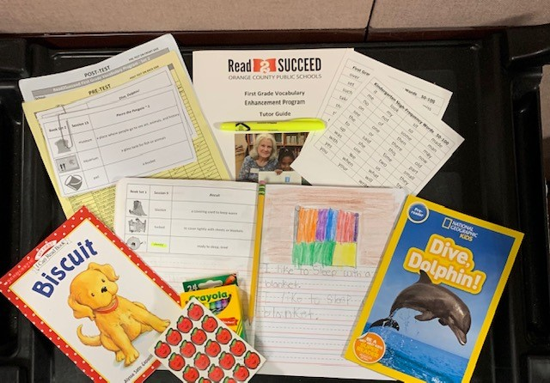
Supplies
Pre/Post Test with mailing envelope
fiction and non-fiction books
Journal sheets
Glue stick
Highlighter
Set of crayons
Journal
Praise stickers
Kindergarten & 1st grade high-frequency word lists

Slide 12
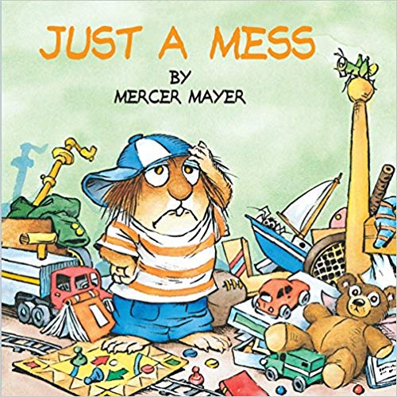
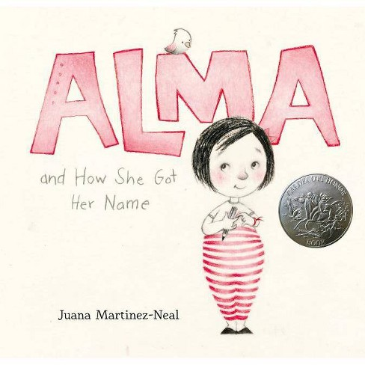
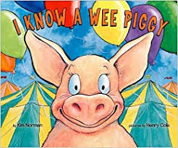
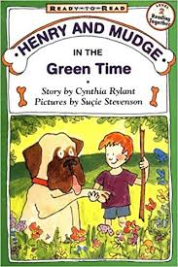
First Grade Set 1 Book Titles

Slide 13
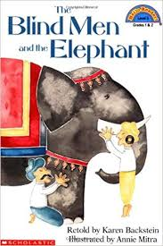
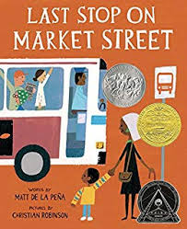
First Grade Set 2 Book Titles

Slide 14
Second Grade Fluency Program

Slide 15
Fluency Research
Read2Succeed (R2S) recognizes the importance of improving students’ reading fluency
The National Reading Council has named fluency as one of the essential components of reading and its direct correlation with reading comprehension has been noted in numerous studies
Our volunteers use a research based program called, “The Six-Minute Solution: A Reading Fluency Program,” with permission from Cambium Learning Group-Sopris
The Six Minute Solution builds fluency through interactive, repeated readings of high-interest and targeted readability passages

Slide 16
Second Grade Reading Fluency Program
Goal is to improve targeted students’ reading fluency
Improvement is measured weekly and by noting the students’ beginning and ending score on passage 101
Students are identified by their teacher or reading coach as needing extra assistance with fluency (reading between 25 and 50 correct words per minute on a second grade passage)
Program is non-remedial and administered by non-educators; students should have a basic understanding of phonics, strong letter sound recognition, and decoding skills

Slide 17
PROGRAM STEP-BY-STEP
Step 1: Connect with the student.
Step 2: Review the three components of reading fluency.
Step 3: Model through the day’s passage reading aloud.
Step 4: Highlight difficult words.
Step 5: Echo read.
Step 6: Choral read all together.
Step 7: Timed reading and graphing.
Step 8: Main idea/Comprehension questions, high-frequency words, and additional activities.
*Adapted from The Six-Minute Solution: A Reading Fluency Program with permission from Cambium Learning Group-Sopris.

Slide 18
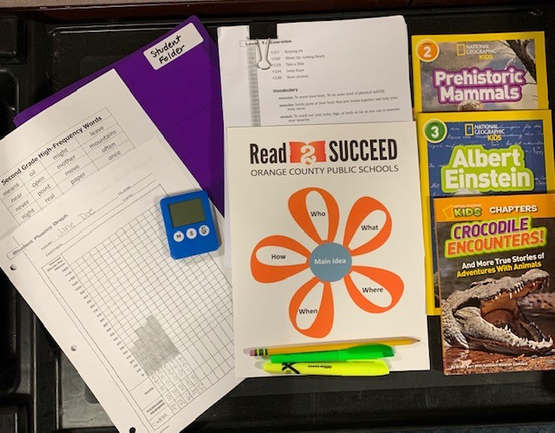
Supplies
Volunteer Folder - Includes passage set, fluency log, reading comprehension questions, high-frequency words, and helpful hints.
Student Folders - Includes passages, program rules, high-frequency words, and fluency graph.
Timer, pencils, stickers, and highlighters.
Additional books for reading with the volunteer (for student to keep).

Slide 19
Why Volunteer with Read2Succeed?
Longstanding, well-organized program with easy to follow step-by-step instructions designed for non-educators.
Each session provides an opportunity for the volunteer and student to see progress in reading skills.
All materials are provided at no cost to volunteers and schools.
Ongoing support for volunteers through email communication and enrichment sessions.
Volunteers and students alike enjoy the program.

Slide 20
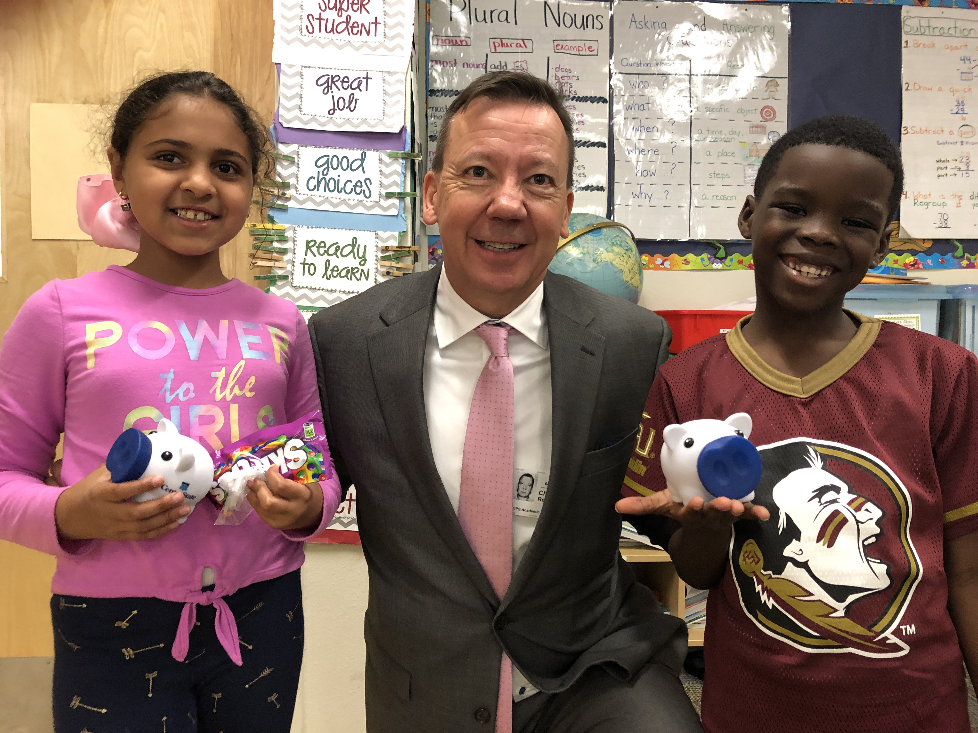
What’s Next?
Read2Succeed team contacts your preferred school
Match student schedule w/ volunteer schedule
Confirm placement
Schedule sent to all parties with start date
Tote bags sent to school
Ongoing support

Slide 21
Connect with US!
Thank you for attending today’s training session.
We look forward to having you as part of the Read2Succeed team!
To watch the training videos please visit:
www.foundationforocps.org
>Volunteers
>Training Videos

