Slide 1
Welcome to Grant Writing Basics
Impact Grants Program
Notes:
Barnhill

Slide 2
“Either write something worth reading, or do something worth writing.”
Benjamin Franklin
Notes:
Teresa

Slide 3
1
Know
Your
Audience
Notes:
Teresa

Slide 4
Know Your Audience
What is the funder’s guiding mission?
Broad areas of interest
Specific focus
Where do they fund projects?
Nationally
Regionally
Locally
Notes:
Teresa

Slide 5
2
Statement
of
Need
Notes:
Teresa

Slide 6
Statement of Need
The statement of need presents the facts and evidence, defining the issue or problem your project addresses. Also known as a problem statement, needs statement, issues statement or needs assessment.
What is the problem or issue?
Who are the people who have this need or problem?
Where does this problem occur geographically?
When is the problem evident?
Why does this problem occur?
Notes:
Teresa

Slide 7
3
Project
Description
Notes:
Teresa

Slide 8
Project Description
The project description is an explanation of your project that illustrates how it provides a solution to the issue or problem outlined in the statement of need.
Includes:
Goal
Objectives
Methods
Notes:
Teresa

Slide 9
Project Description
Goal
An intangible and abstract statement that describes in broad terms what the project will accomplish
Weak
To improve literacy skills
Strong
To help elementary students read at grade level
Notes:
Teresa

Slide 10
Project Description
Objectives
Tangible, specific, concrete outcomes achievable in a specified amount of time, that represents a step towards accomplishing the goal
Use the S.M.A.R.T. Method when writing objectives
Specific
Measurable
Attainable
Realistic
Time-bound
Notes:
Teresa

Slide 11
Project Description
Examples of Objectives
Weak
Provide reading tutoring to 1st and 2nd grade students.
Strong
Build vocabulary and reading fluency skills for 1,000 1st and 2nd grade students by providing 30 weeks of reading tutoring.
Notes:
Teresa

Slide 12
Project Description
Methods
Specific activities that need to take place to achieve the goal and objectives;
answers the question how by providing a detailed description of the execution of the project
Enables the reviewer to visualize the project in action.

Slide 13
4
Evaluation
and
Measurement
Notes:
Teresa

Slide 14
Evaluation
The evaluation provides the details on the methods and benchmarks that will be used to measure success; explains how progress and outcomes will be measured.
Were the objectives met using the specified methods?
Was an impact was made on the problem identified in the statement of need?
Notes:
Teresa

Slide 15
Evaluation
How will you measure progress and outcomes?
Quantitative methods
Measure or count data using statistical analysis such as averages, means, percentiles, and frequency.
Qualitative methods
Study of processes or meanings, using direct or indirect contact with people through interviews, observation, or review of relevant documents.
This method does not measure.
Notes:
Teresa

Slide 16
Evaluation
Examples of Strong Evaluation Statements
Quantitative
Second grade students’ adjusted reading fluency score will increase an average of 75 points after receiving 30 weeks of tutoring as measured by i-Ready, Assessment Period 1 to Assessment Period 3.
Qualitative
After participating in Middle School Book Clubs during the 2016-17 school year, 90 percent of the students will express an increased interest in reading.
Notes:
Teresa

Slide 17
5
Timeline

Slide 18
Timeline
The timeline outlines the major tasks of your project, from beginning to end, during the grant’s funding period.
Provide a detailed breakdown – monthly and/or quarterly - that includes:
Tasks for accomplishing and evaluating the project
Reporting deadlines – both narrative and financial
Notes:
Teresa

Slide 19
Timeline Sample
June 2018: Research, write, proof submit grant application
October/November2018: Receive grant money and place supplies and equipment orders
October/November 2018: Conduct pre-test measurement tool (if applicable)
November 2018: Receive supplies, equipment, etc.
December 2018: Implement project (give specifics)
December 6, 2018: Expend ALL grant money
December 13, 2018: Submit expense summary with backup documents (include invoices/check copies) and return any unspent grant money
January – April 2019: Continue project and give specifics details (if applicable)
April 2019: Conduct post-test measurement tool (if applicable)
May 17, 2019: Submit final evaluation
Notes:
Teresa

Slide 20
6
Budget
Notes:
Teresa

Slide 21
Budget
The budget is the financial description - both numerical and narrative - of the project illustrating income and expenses.
Income is a projection of where funding will come from for the project - both secured and pending.
Expenses are the actual costs of the project. Be sure to do your budget homework prior to starting your application.
Not all funders will require income as part of the budget, but will always request expense information.

Slide 22
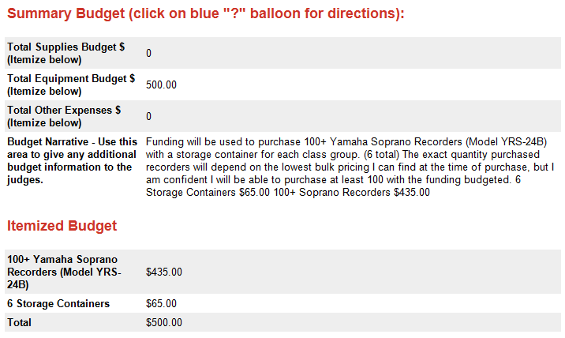
Budget Sample
Notes:
Teresa

Slide 23
7
Tips
Notes:
Teresa

Slide 24
2018-19 Impact Grant Opportunities
Click links

Slide 25
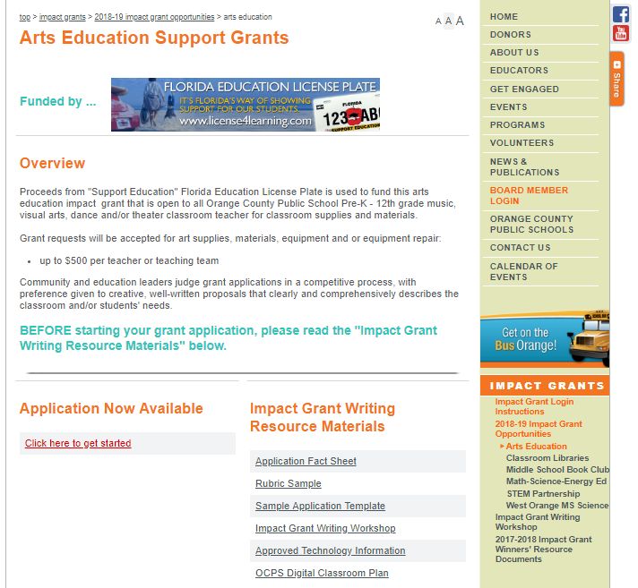
Read fact and know the rules BEFORE you start.
Read the facts and understand the process…

Slide 26
Fact Sheet & Rubric

Slide 27
Timeline Sample
June 2018: Research, write, proof submit grant application
October/November2018: Receive grant money and place supplies and equipment orders
October/November 2018: Conduct pre-test measurement tool (if applicable)
November 2018: Receive supplies, equipment, etc.
December 2018: Implement project (give specifics)
December 6, 2018: Expend ALL grant money
December 13, 2018: Submit expense summary with backup documents (include invoices/check copies) and return any unspent grant money
January – April 2019: Continue project and give specifics details (if applicable)
April 2019: Conduct post-test measurement tool (if applicable)
May 17, 2019: Submit final evaluation
Notes:
Teresa

Slide 28
Tips
Read the grants fact sheets and know the rules BEFORE you start
Be sure to answer the questions being asked
Write clear and concise sentences
Review for grammar, spelling and punctuation
Don’t use jargon or acronyms
If you must, be sure to provide an explanation
Keep in mind that the character space count usually includes spaces
Notes:
Teresa

Slide 29
8
Setting up your use account
Notes:
Susan

Slide 30
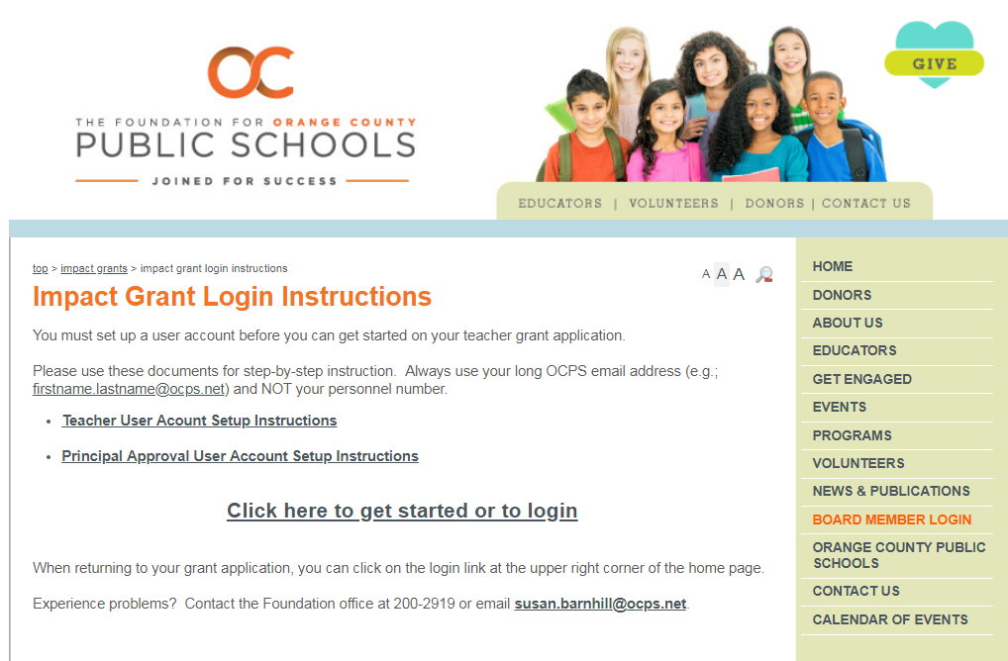
Setting up your use account
Notes:
Susan

Slide 31
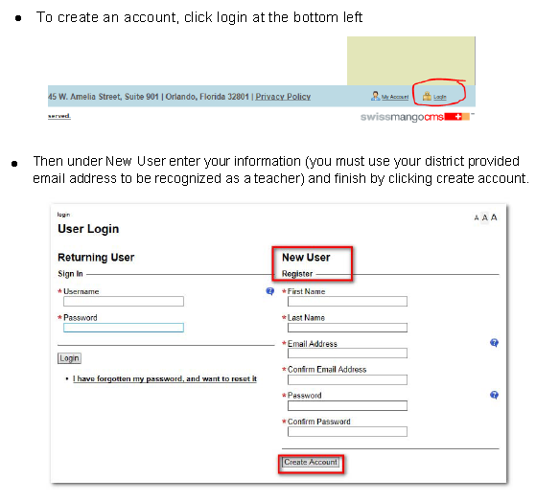
Setting your user account (continued)
Notes:
Susan

Slide 32
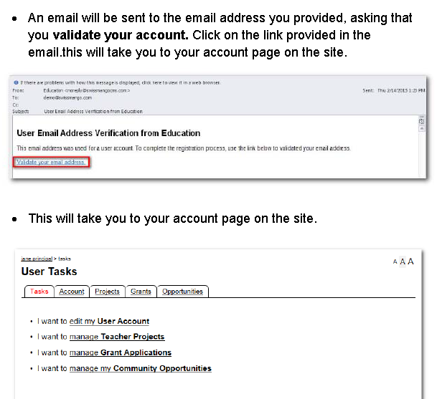
Setting your user account (continued)
Notes:
Susan

Slide 33
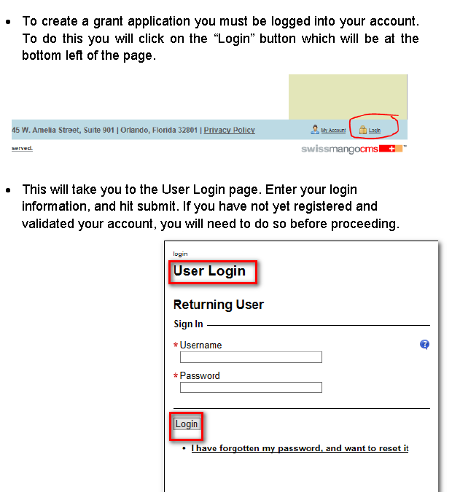
Setting your user account (continued)
Notes:
Susan

Slide 34
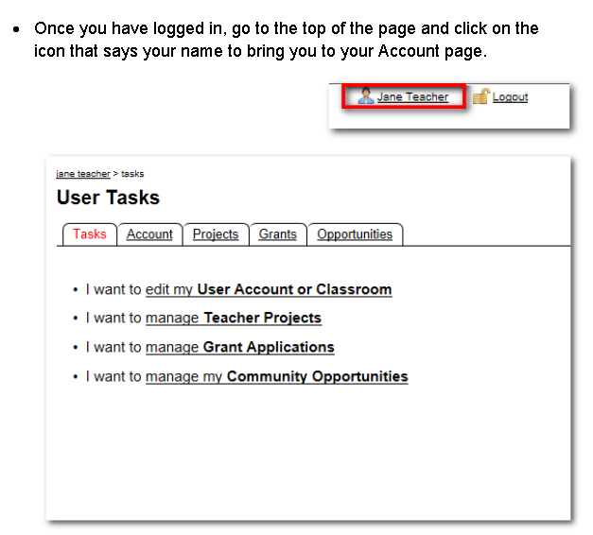
Setting your user account (continued)
Notes:
Susan

Slide 35
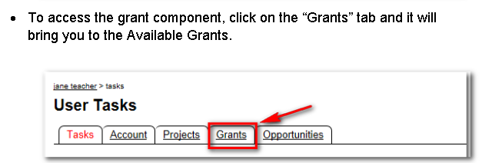
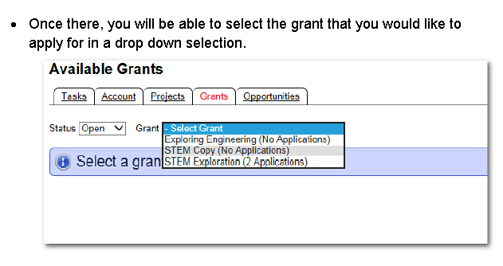
10
Accessing
grant component
Notes:
Susan

Slide 36
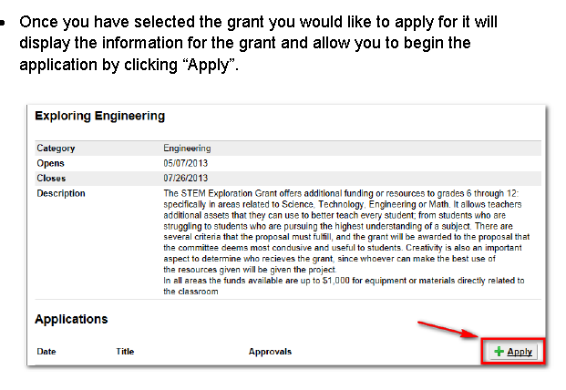
Accessing
grant component
(continued)
Notes:
Susan

Slide 37
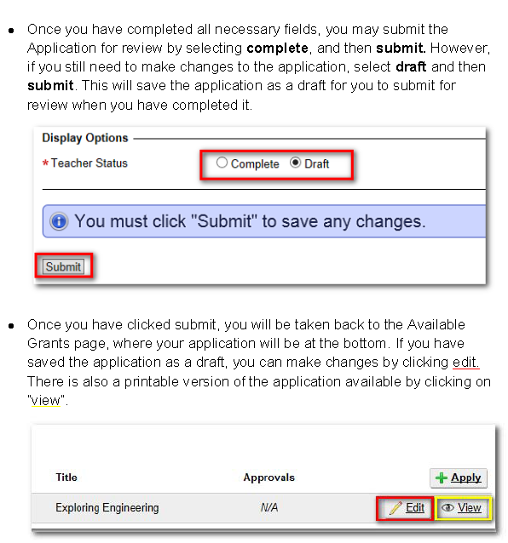
Accessing
grant component
(continued)
Notes:
Susan

Slide 38
Once you have submitted your application as “complete,” your principal will receive a copy for review and approval.
You principal will also need a user account to review and approve your grant application. He/she will follow the same steps as you did to set up, except they will not answer the “I am teacher” question with a yes.
Once your principal has set up his/her user account, reviewed your application and approved, you will be able to see their approval. Also, the “admin” approval indicates that the Foundation team has approved it to go to the judging phase of the grant process.
It is your responsibility to let your principal know you are applying for a Foundation grant, and to let him/her know they will receive a copy via email for approval. Also let them know the Foundation team is available to assist with setting up and/or updating their user account.
Accessing
grant component
(continued)
Notes:
Susan

Slide 39
9
Judging
Who judges your grant applications - bankers, educators, IT professionals, volunteer parents, grant writers, retired businessmen, utility / hospital executives ...
Notes:
Susan

Slide 40
Know The Judging Process
Who are the judges?
Volunteers from the following fields: bankers, educators, IT professionals, volunteer parents, grant writers, retired businessmen, utility / hospital executives, etc.
What do they look for?
Well-written grant application – grammar, punctuation, etc.
Applications that they understand – if they are not educators, they may not understand your education acronyms
Applications that can be easily scored using the grant rubric
Notes:
Susan

Slide 41
Timeline Sample
June 2018: Research, write, proof submit grant application
October/November2018: Receive grant money and place supplies and equipment orders
October/November 2018: Conduct pre-test measurement tool (if applicable)
November 2018: Receive supplies, equipment, etc.
December 2018: Implement project (give specifics)
December 6, 2018: Expend ALL grant money
December 13, 2018: Submit expense summary with backup documents (include invoices/check copies) and return any unspent grant money
January – April 2019: Continue project and give specifics details (if applicable)
April 2019: Conduct post-test measurement tool (if applicable)
May 17, 2019: Submit final evaluation
Notes:
Teresa

Slide 42
Notes:
Teresa and Susan

Slide 43
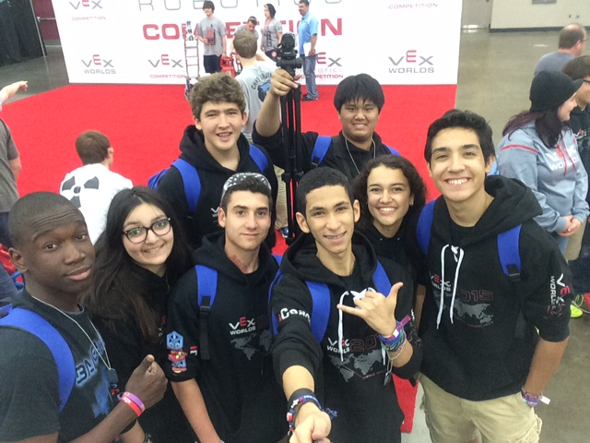
Thank you for all you do for our students!
We want you to be the next grant winner!

